Slide 1
IBM University Engagement Project Submission
“Exploring the Power of Agentic AI with IBM Granite and LangFlow”

Slide 2

Project Tile – Agentic Career Counseling Companion
Domain of Project – Education Technology , Agentic AI
Student Name | Recent Passport Photo | Email ID | Mobile number [WhatsApp]
RAPOLU VARUN |  | 23p61a67f4@vbithyd.ac.in | 9059865932

Slide 3
Problem Statement
Agentic Career Counseling Companion
The Challenge
Students often struggle to make informed career decisions due to fragmented access to
guidance, limited self-awareness of academic strengths, and rapidly evolving industry landscapes.
Traditional counseling methods lack personalization and scalability, leading to missed opportunities and career mismatches. The challenge is to develop an intelligent, autonomous agent that continuously monitors student performance, evolving interests, and real-time labor market trends to deliver tailored career pathway suggestions. This would empower students to make confident, future-ready decisions with minimal dependency on manual intervention.
Technology – Use of IBM Cloud Lite services / IBM Granite is mandatory.

Slide 4
Proposed Solution -
The Agentic Career Counseling Companion is an AI-powered, multi-agent career guidance platform that leverages IBM Cloud Lite and IBM Granite foundation models to provide personalized, autonomous, and data-driven career counseling. The system continuously analyzes a student's academic performance, skills, interests, certifications, and extracurricular activities while incorporating real-time labor market insights to recommend the most suitable career pathways.
Using a Retrieval-Augmented Generation (RAG) architecture, the platform retrieves trusted information on careers, higher education opportunities, certifications, industry trends, and in-demand skills from reliable knowledge sources. IBM Granite processes this information to generate personalized recommendations, explain career options, identify skill gaps, and create actionable learning roadmaps.

Slide 5
Technology Used
IBM Cloud Lite – Provides a free cloud platform to build, deploy, and manage the AI-powered career counseling application.
IBM Granite Foundation Model – Powers natural language understanding, reasoning, and personalized career recommendations.
IBM Watsonx.ai – Enables AI model deployment, prompt engineering, embeddings, and responsible AI development.
Multi-Agent AI Architecture – Uses specialized AI agents that collaborate to analyze student profiles, recommend careers, and monitor industry trends.
Python – Serves as the primary programming language for developing the AI application and backend services.
Flask / FastAPI (Backend) – Provides lightweight and efficient APIs to connect the frontend, AI models, and databases.
React.js (Frontend) – Builds an interactive, responsive, and user-friendly interface for students and counselors.
IBM Cloud Object Storage / Cloudant Database – Securely stores student data, career resources, and application information.
Git & GitHub – Used for version control, collaboration, and source code management throughout the project.

Slide 6
Chat Input – Accepts student queries and career-related information.
IBM Granite LLM – Generates career recommendations and answers using the Granite foundation model.
RAG Pipeline – Retrieves relevant career, course, and job market information before response generation.
Vector Store (FAISS/Chroma) – Stores and retrieves career knowledge efficiently for RAG.
Output Parser – Formats AI responses into clear, user-friendly career guidance.
API Component – Connects Langflow workflows with the frontend and backend application.
Memory Component – Maintains conversation history to provide personalized and context-aware counseling.

Slide 7
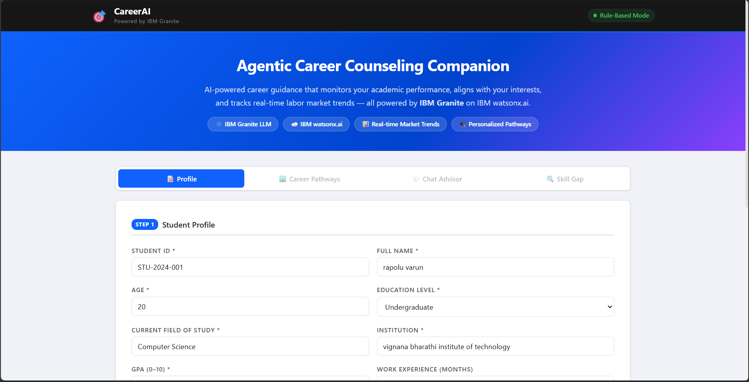
Project Output - Dashboard

Slide 8
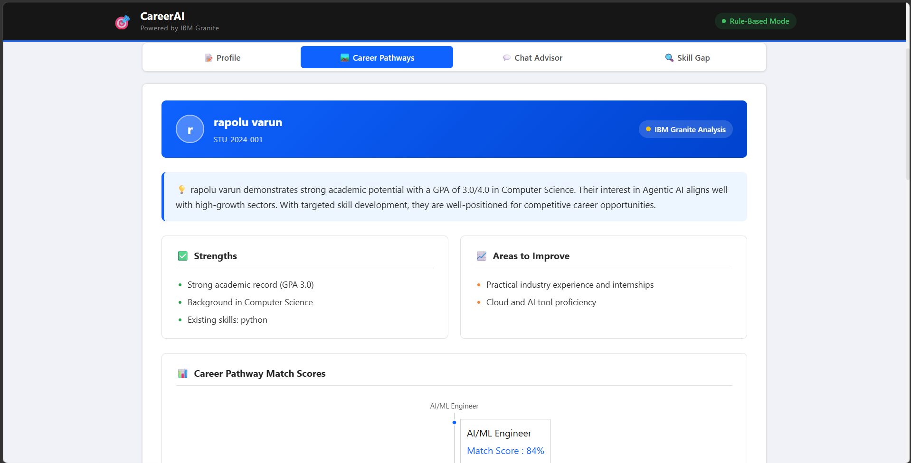
Career Pathway

Slide 9
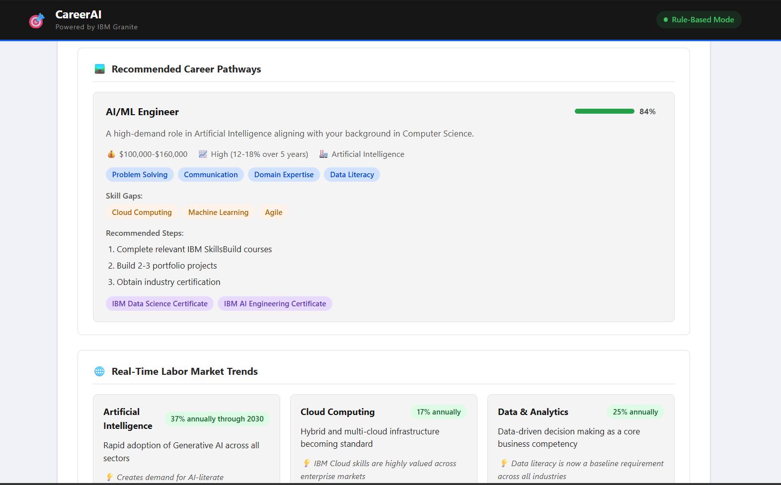

Slide 10
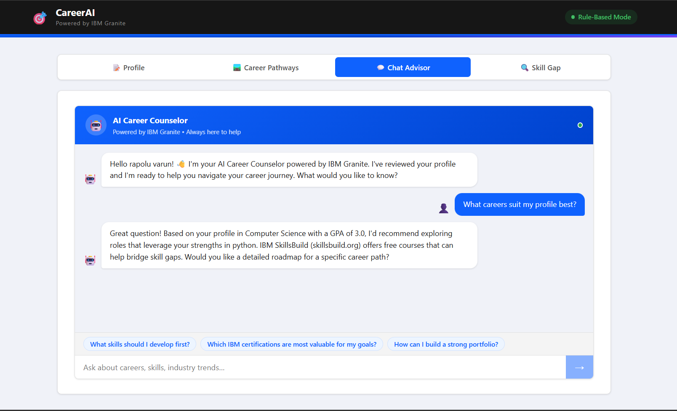
Chat Advisor

Slide 11
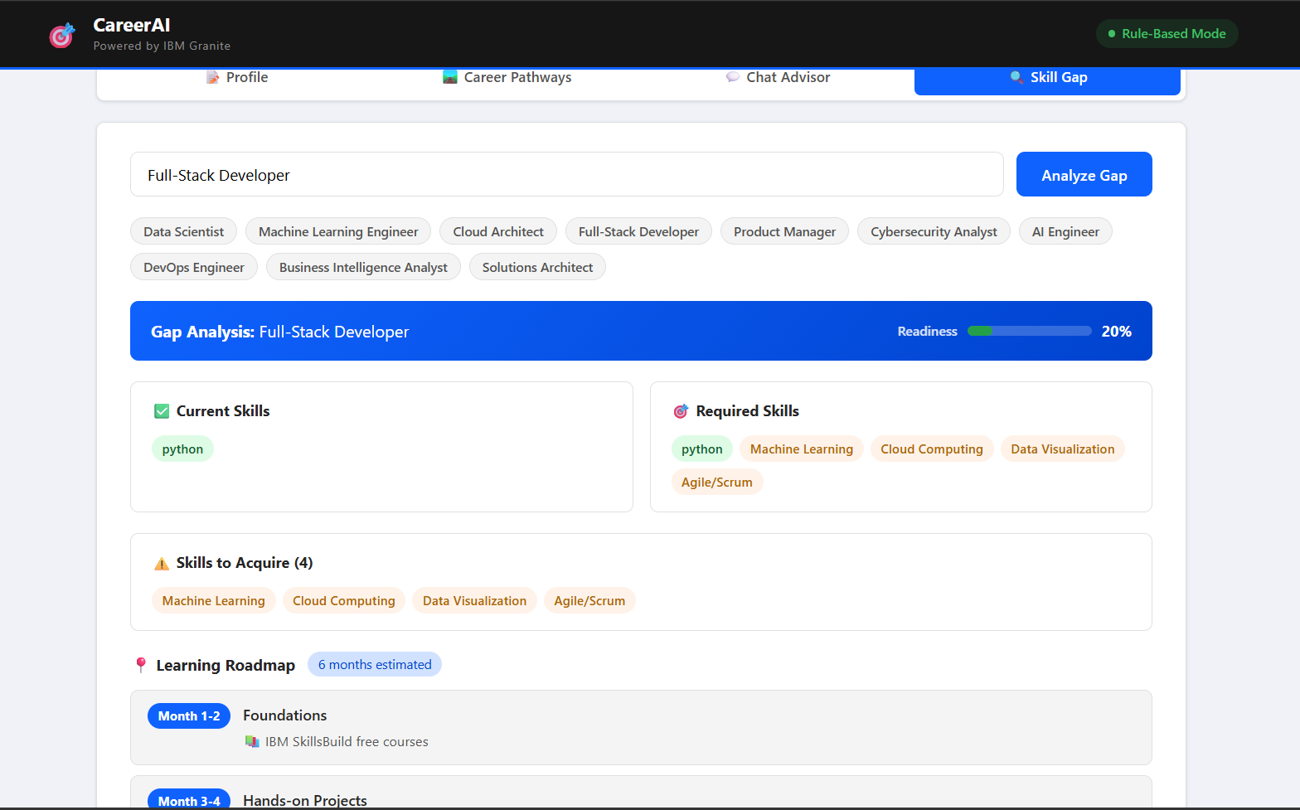
Skill Gap

Slide 12

Role of Agentic AI in the solution
Agentic AI serves as the core intelligence of the proposed system by acting as an autonomous career advisor that continuously analyzes a student's academic performance, skills, interests, certifications, and project experience while monitoring real-time industry trends and job market demands. Using IBM Granite on IBM Cloud Lite, it reasons over this information to identify skill gaps, recommend suitable career paths, generate personalized learning roadmaps, and proactively update its suggestions as the student's profile or market conditions change. Unlike traditional career counseling or rule-based chatbots, the Agentic AI independently makes informed decisions, adapts to evolving data, and provides continuous, personalized guidance with minimal human intervention, enabling students to make confident and future-ready career decisions.

Slide 13
Novelty and Uniqueness
The proposed solution goes beyond traditional career guidance systems by leveraging Agentic AI to provide continuous, autonomous, and personalized career mentoring instead of one-time recommendations. Unlike conventional platforms that rely on static questionnaires or manual counseling, the system dynamically analyzes a student's academic progress, skills, interests, certifications, and real-time job market trends to generate and continuously update personalized career pathways and learning roadmaps. Powered by IBM Granite on IBM Cloud Lite, it proactively identifies skill gaps, recommends relevant courses and internships, and adapts its guidance as industry demands evolve. This intelligent, self-improving, and context-aware approach ensures students receive timely, data-driven career recommendations with minimal human intervention, making the solution highly innovative and future-ready.

Slide 14
Git Hub Link
Github URL – https://github.com/varun014d/careerai.git
·
·
·

Slide 15
Future Scope
Advanced AI Integration and Personalized CareerDevelopment The proposed Agentic AI Career Guidance System can be enhanced by integrating with college ERP, LMS, GitHub, LinkedIn, and online learning platforms to provide a unified student profile. Using IBM Granite, it can continuously analyze student progress, predict placement readiness, identify skill gaps, and generate personalized career roadmaps. Future enhancements include AI-powered resume analysis, mock interviews, internship and scholarship recommendations, and multilingual support. These improvements will make the system more intelligent, adaptive, and accessible for students' long-term career development.
Real-Time Industry Intelligence and Scalable Deployment
The system can be expanded to monitor real-time job market trends, emerging technologies, salary insights, and hiring demands through integration with job portals. It can proactively update career recommendations and learning paths based on changing industry requirements. The platform can be deployed across universities, training institutes, and organizations for career guidance and workforce development. With continuous learning from user feedback, it can evolve into a lifelong AI career companion that provides adaptive and future-ready guidance.
·
·
·

Slide 16
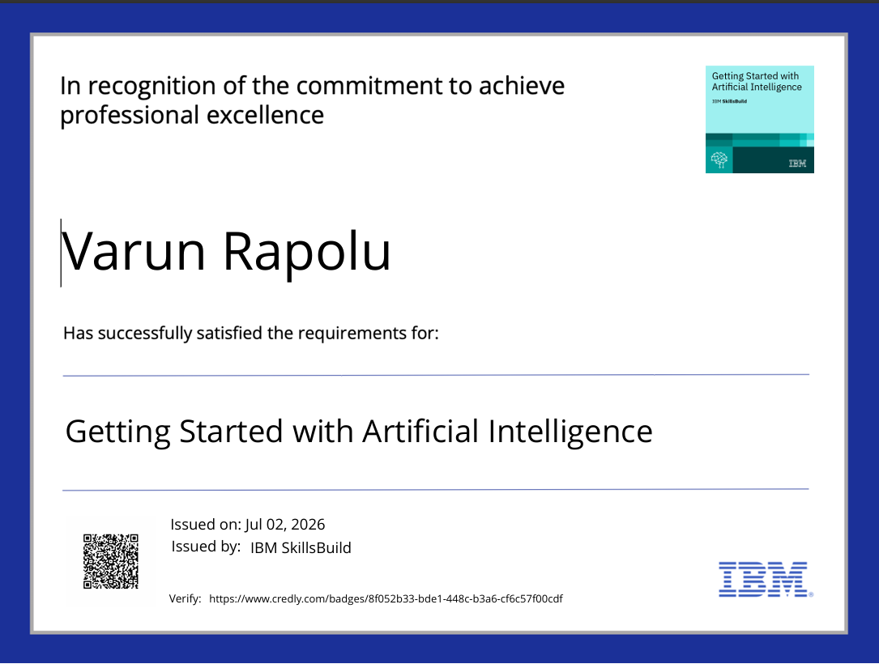
Certificates Earned:
Getting Started with Artificial Intelligence

Slide 17
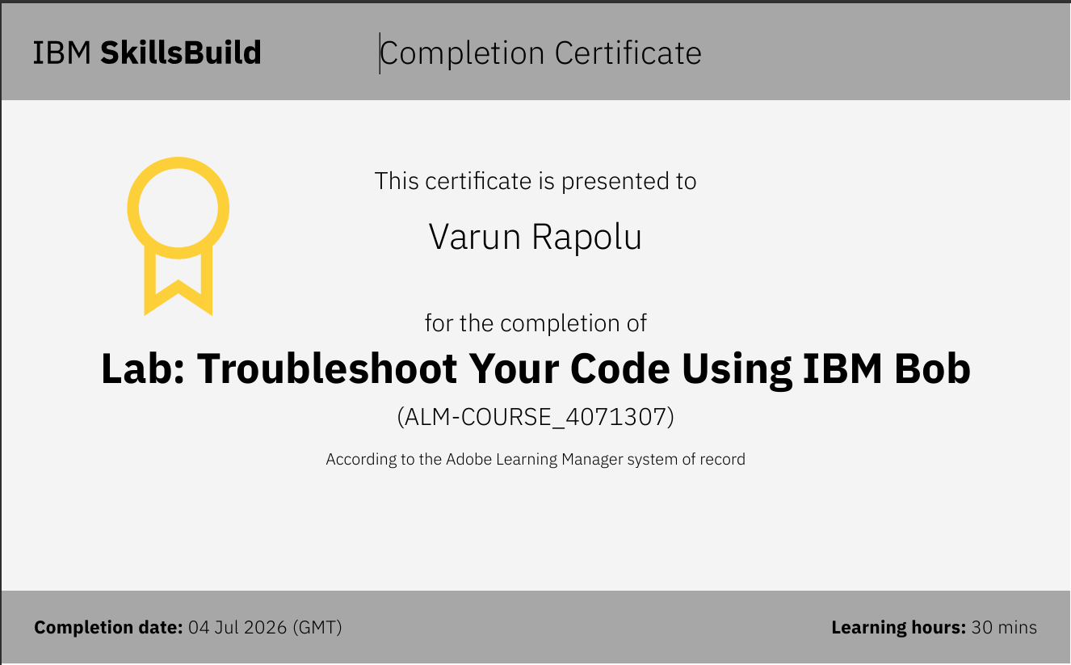
Certificates Earned:​
Troubleshoot Your Code Using IBM Bob

Slide 18


